Slide 1

Guarding Against Job Scams : Harnessing Decision Tree Analysis
By:
T. Pranitha(217Z1A05H4)
S. Sai Sridhar Naidu(217Z1A05G6)
T. Madhava Swamy(217Z1A05H6)
Guided by:
Mr. G. Sravan Kumar
(Professor)

Slide 2

OUTLINE
ABSTRACT
INTRODUCTION
PROPOSED SYSTEM
EXISTING SYSTEM
REQUIREMENTS SPECIFICATIONS
DESIGN ARCHITECTURE
MODULES
RESULT
CONCLUSION

Slide 3

ABSTRACT
We are going to apply machine learning algorithms like, decision trees and naïve bayes.
Fake job post made job seekers into losing money or sharing personals.
Firstly we are using text mining to extract important features and also Natural Language processing(NLP).

Slide 4
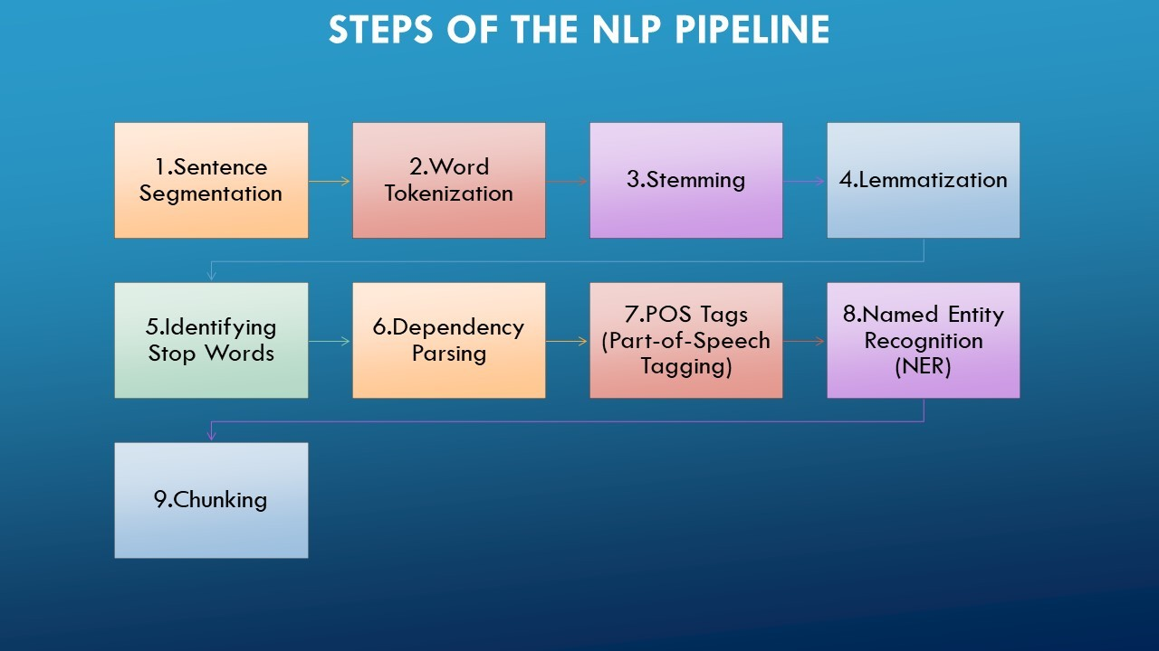

INTRODUCTION
Data Collection
Data Preprocessing
Feature Engineering
Model Selection
Model Evaluation
Deployment(optional)

Slide 5

EXISTING SYSTEM
Mostly depends on manual checks , simple keyword filters and pattern recognition
Scalability Issues, Limited detection.
Implemented by traditional methods. Lack of advanced techniques.

Slide 6
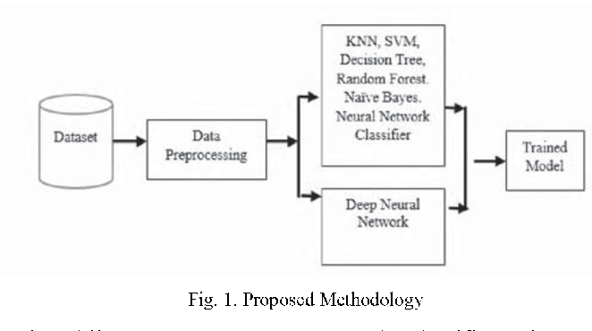
PROPOSED SYSTEM
Collect comprehensive dataset.
Model Selection.
Very effective due to accurate detection.
Data Preprocessing using NLP.
Fast response time.
Evaluating the data.

Slide 7
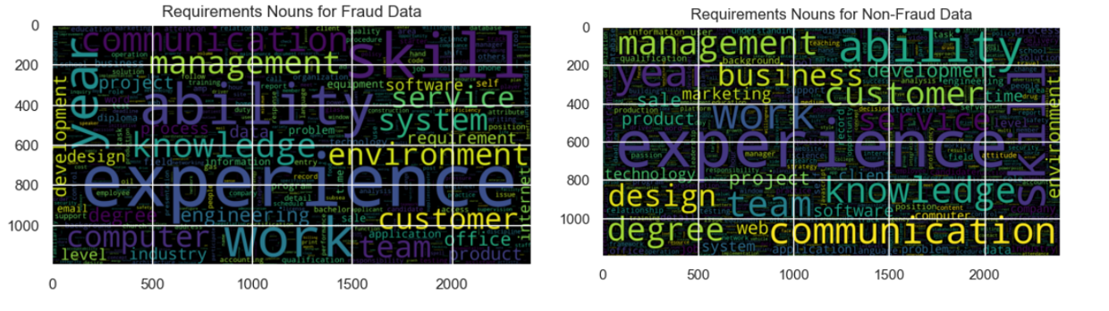
VISUALIZATION OF COMMON WORDS

Slide 8
REQUIREMENTS SPECIFICATIONS
Hardware Requirements
Processor : Pentium-IV
RAM : 4GB
Software Requirements
Operating system: Windows 7
Designing : Html, CSS, Javascript
Hard Disk:20GB
Coding Language : Python

Slide 9
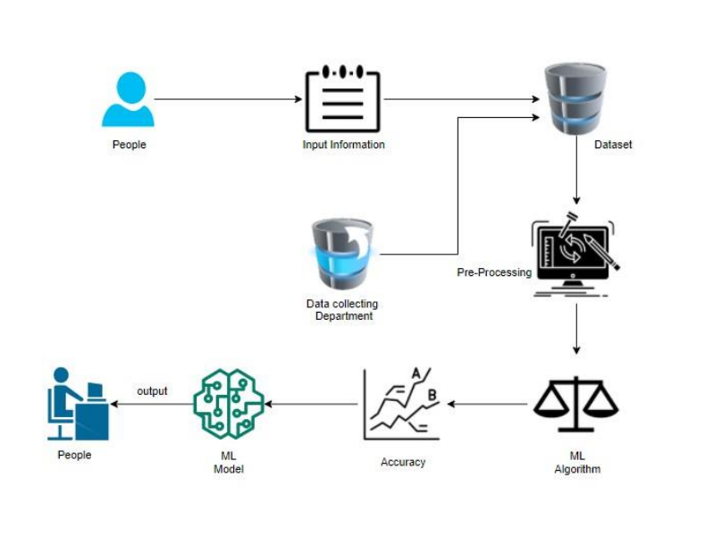
DESIGN ARCHITECTURE

Slide 10
MODULE
Data Processing
Feature Engineering
Build Decision tree and Naïve bayes
Deploy And Monitor
Data Collection

Slide 11
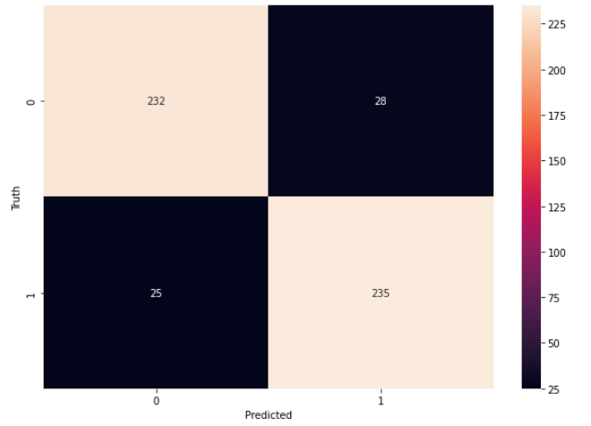
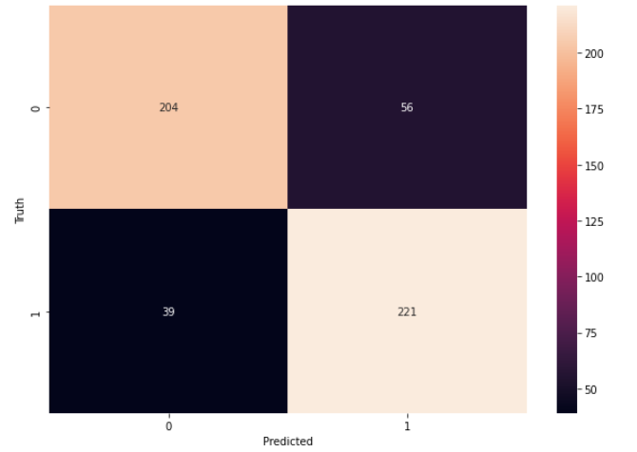
RESULTS
Naïve Bayes Approach
Decision Tree Approach

Slide 12
CONCLUSION
Ethical Considerations
Ensuring the privacy and confidentiality of job seekers.
Helps job portals automatically filter out fake job postings.
Future Improvement
Focus on using advanced techniques and expanding datasets.
Practical Applications
Impact
Improving safety for job seekers and reliability for job platforms.

Slide 13


